Slide 1
Environmental
Presentations:
Barbara Heinonen from the city of Mariehamn
Vesa Vanninen from Pirkkala municipality
Moderator: Elin Slätmo, Nordregio
Rapporteur: Theresia Bilola Epse Samfoga Doh, City of Turku, Finland
How do you tackle climate change within your work (in the municipality)?
How do you work for affordable clean energy?
What type of help is needed to further the work from your perspective?

Slide 2
Globalt och lokalt ansvar
MARIEHAMNS STADS MILJÖPROGRAM 2019-2030
Stadsdirektör Barbara Heinonen 28.10.2019

Slide 3
Nordiska föregångare i arbetet med Agenda 2030
Mariehamn är en av 15 kommuner som har utsetts av Nordregio (Nordiska ministerrådet) som föregångare i hur Agenda 2030 implementeras på lokal nivå i Norden.
Mer att läsa om detta i NORDREGIO RAPPORT 2019:5

Slide 4
Nordiska föregångare i arbetet med Agenda 2030, Nordregio rapport 2019:5

Slide 5
Mariehamns stads miljöprogram
Programmet har stöd i utvalda mål i Agenda 2030

Slide 6
TVÅGRADERSMÅLET, det kräver åtgärder!
När världens länder nu ska uppfylla det glo­bala klimatavtalet om att hålla klimatföränd­ringarna väl under två grader, spelar städerna en nyckelroll.
Därför har och kommer Marie­hamn prioritera arbetet med att minska kol­dioxidutsläppen.
Klimatmål: Koldioxidutsläppen ska minska med 90 % till 2030, hittills har de minskat med 70 % sedan 2002!

Slide 7
Mariehamn en pionjär inom hållbar fjärrvärme Källa: Finsk energiindustri 16.2.2018

Slide 8
Hållbar fjärrvärme
En långsiktig utbyggnad och uppgradering av fjärrvärmesystemet har inneburit en minskad import av brännolja med ca 14 500 ton årligen och det fossila koldioxidutsläppet med 46 100 ton.
Genom nybyggnation av en biopanna och effektivisering av de befintliga pannorna kommer det innebära att vi har 100 % förnybar energi i fjärrvärmen inom snar framtid.

Slide 9
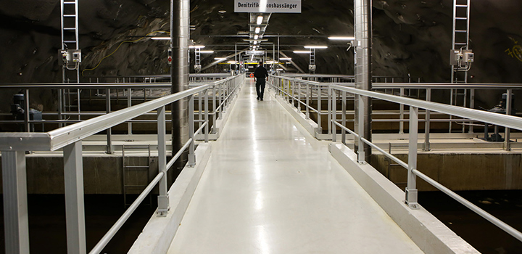
Produktion av förnybar energi
Genom medveten investering och optimering i stadens reningsverk har elproduktionen med hjälp av biogas ökat.
Kan producera drygt 425000 kWh, energimängden kan jämföras med vad 20 normalvillor förbrukar på ett år.

Slide 10
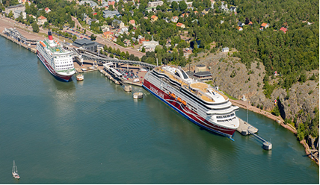
Grön milstolpe i Västra hamnen
Närmare 2 miljoner personer kommer årli­gen till Åland, de flesta anländer med någon av färjorna till Mariehamns Västerhamn.
Under 2017 färdigställdes i Västra hamnen en anläggning som möjliggör landström till Vikinglines pas­sagerarfärja Rosella. Att Rosella byter olja mot förnybar el under dess kajtid innebär en reduktion av 2000 ton koldioxid.

Slide 11
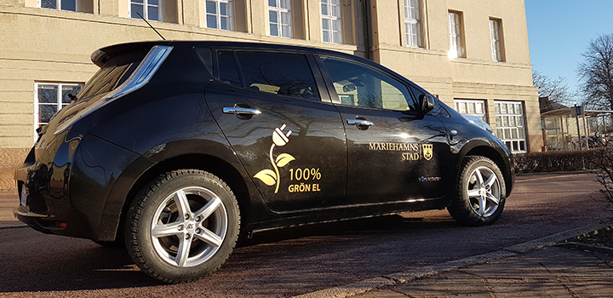
Vi laddar för en renare och tystare stadsmiljö
Mariehamns stad arbetar aktivt för att få in elbilar i vår förvaltning. För varje fossilbil som fasas ut minskar koldioxidutsläppen med 1,5-2 ton årligen, bilarna laddas givetvis med förnybar el.

Slide 12
Bygga hållbart- Övernässkolan- Ålands första lågenergiskola

Slide 13
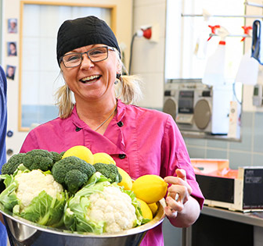
Klimatsmart mat i skolor och daghem
Klimatsmart dag har varit ett inslag i Mariehamns skolor och daghem under en längre, vilket innebär att en dag i veckan serveras enbart vegetariskt.
Inom stadens skolor och daghem serveras ca 1600 portioner dagligen vilket innebär att varje veckas klimatsmarta dag minskar klimatbelastningen med 2400 kg koldioxid.

Slide 14
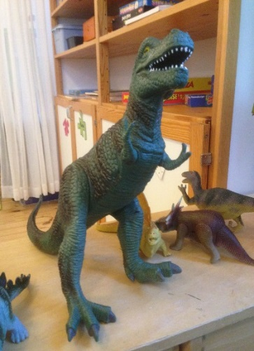
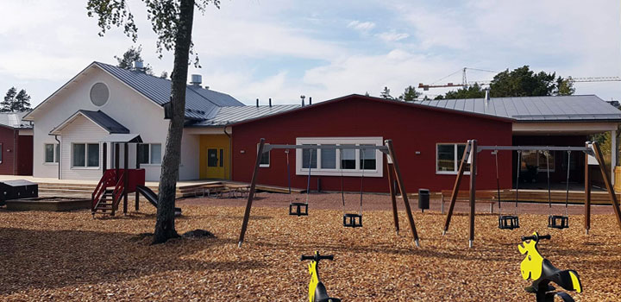
Hållbar konsumtion och ökad biologisk mångfald
Staden har länge haft miljömål som anger att vi ska öka andelen miljömässiga produkter i vår verksamhet. Som ett led i detta arbete genomförde vi 2015 projektet Giftfria daghem.
Vilket resulterade i att bl.a. att onödiga kemikalier nu är borttagna och alla städkemikalier miljömärkta.

Slide 15
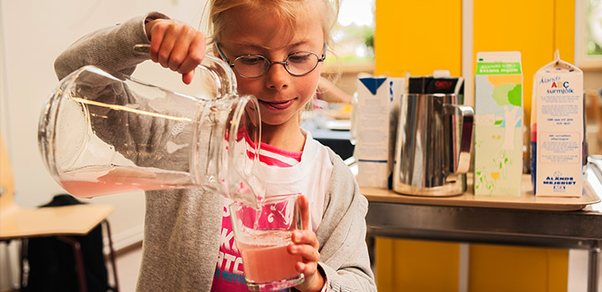
Mer ekologisk mat i skolor och daghem
Den ekologiska andelen av maten som serveras till barnen i stadens skolor och daghem ökar, toppnoteringen 2017 är 35,2 procent.

Slide 16
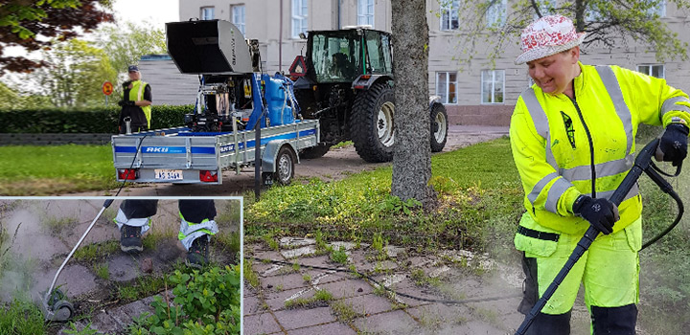
Sprider värme och gör staden vacker!
Kemikaliefri ogräsbekämpning: Sedan en tid tillbaka har Mariehamns stads med goda resultat använt hetvatten till ogräsbekämpning. Metoden innebär att hett vatten sprids över ogräset och skadar ogräsets cellstruktur med den höga värmen.

Slide 17
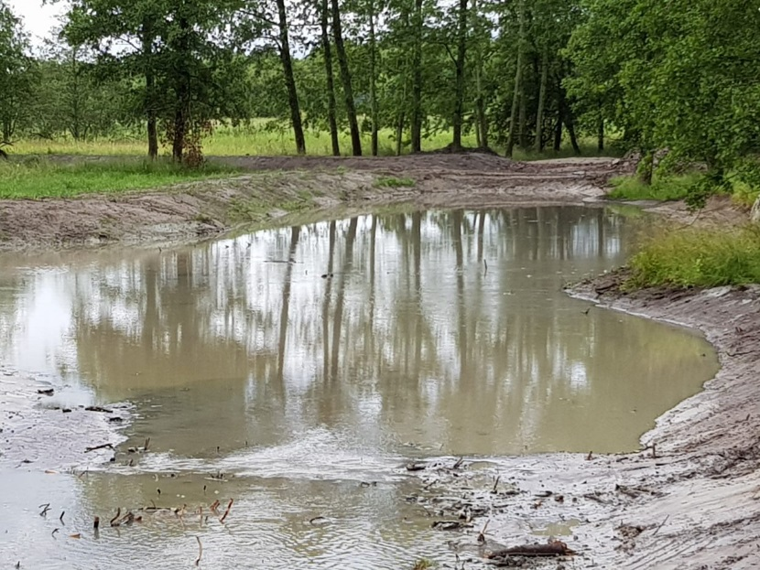
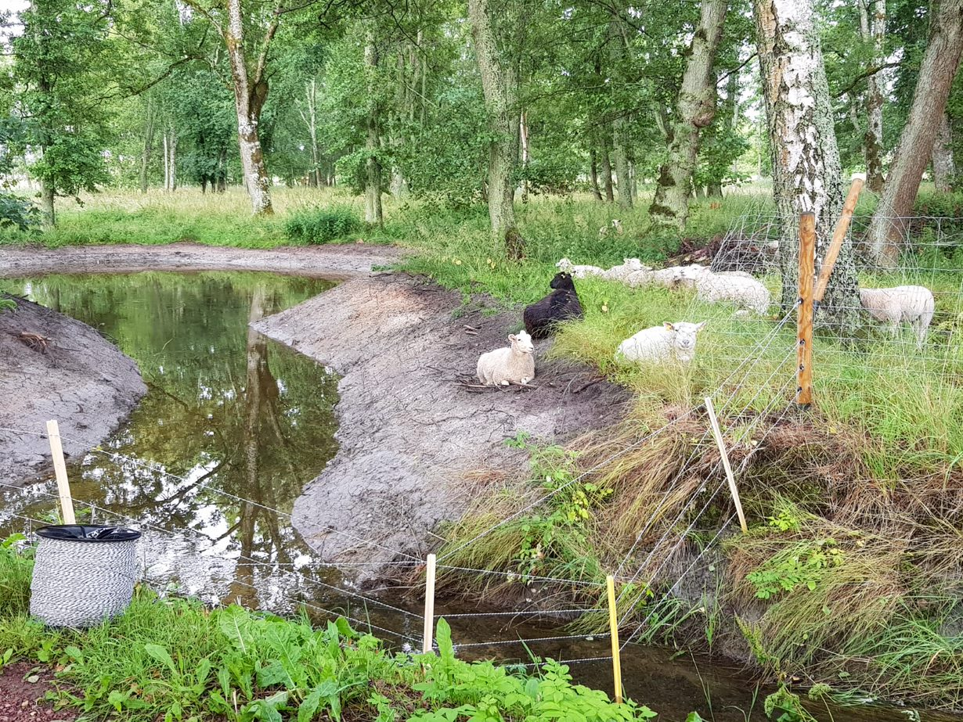
Åtgärder för ett renare Östersjön och ett ökat fiskbestånd
En våtmark färdigställdes sommaren 2019, som kommer att rena drygt en halv miljon kubikmeter på föroreningar samt skapar lekområde för fisk.

Slide 18
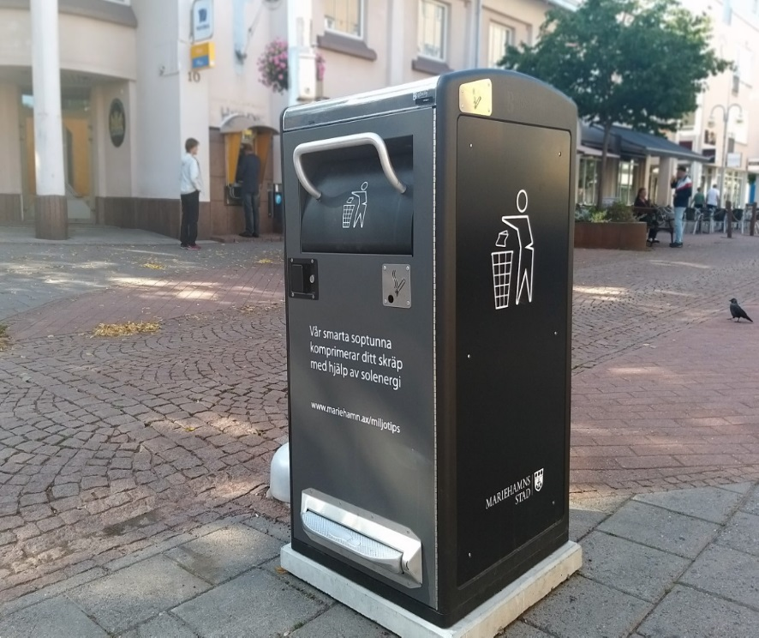
Nya smarta soptunnor med solceller och som kommunicerar
Soptunnorna försörjs av energi som produceras av solceller.
De har en inbyggd komprimator som tycker ihop skräpet och detta innebär färre tömningar
De skickar en signal när de ska tömmas

Slide 19
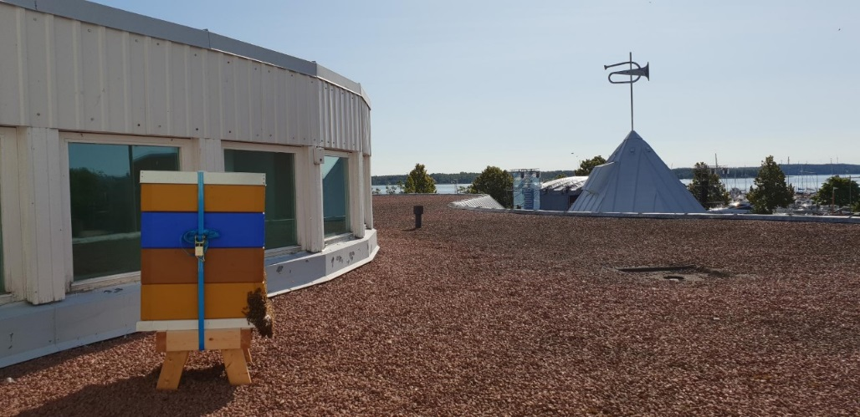
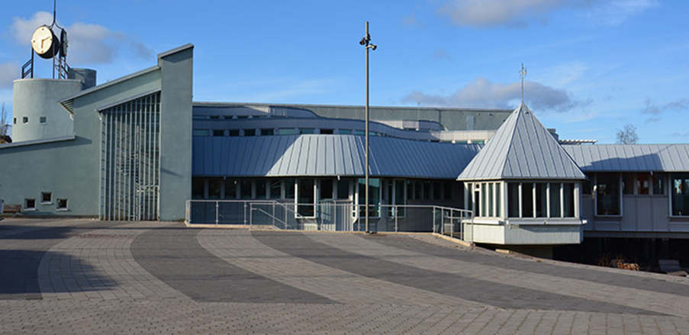
Bikupor på stadens bibliotek

Slide 20
TACK!

Slide 21
ENVIRONMENTAL FOCUS PIRKKALA Tampere region
Vesa Vanninen
Environmental manager
Pirkkala Municipality
vesa.vanninen@pirkkala.fi

Slide 22
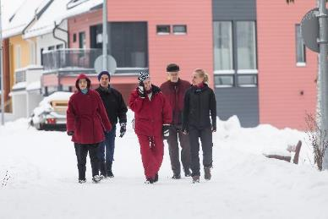
pirkkala
Population 19 600
The growth of a population has been one of the fastest in Finland
Total area 103,8 km²
Ground area 81,43 km². Forest covers about half of Pirkkala’s surface area.
Coastline 72 km, of which Lake Pyhäjärvi coastline in 53.5 km
A separate poll suggests that residents of Pirkkala are the most satisfied with their municipality in Finland (together with the residents of Kauniainen)

Slide 23
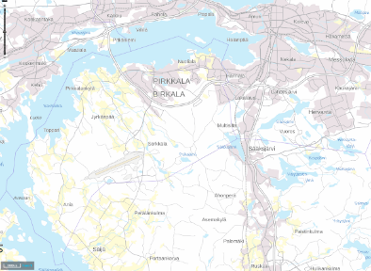
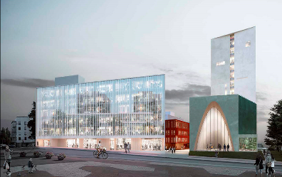
pirkkala
Environmental noise is one of the main factors that weaken the quality of life in Pirkkala. The road traffic and airplanes are the most significant sources of environmental noise.
Through land use planning the municipality of Pirkkala have strongly focused on strengthening the center of Pirkkala and the main public transport quality corridor.

Slide 24
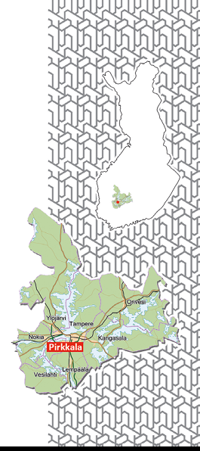
TAMPERE CITY REGION
Pirkkala is part of the wider Tampere city region with a population of 390 000
Tampere City Region includes the city of Tampere, towns of Kangasala, Nokia, Orivesi and Ylöjärvi and the municipalities of Lempäälä, Pirkkala and Vesilahti
Tampere City Region is the second largest growth center in Finland
Tampere region has been rated as the most desirable place to live in Finland

Slide 25
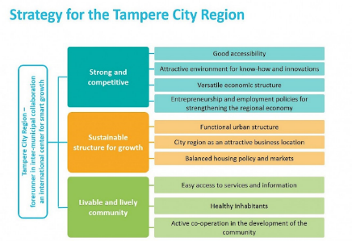
COOPERATION
Tampere City Region is a forerunner in the political and operational co-operation between the municipalities, most notably in land use, housing and transport issues.
Intercommunal cooperation is organised by the joint authority of Tampere City Region and is funded by the municipalities of the City Region.
Subregional strategy and Structural Plan 2040 form he basis for the cooperation.
The municipalities in the Tampere region and the State of Finland has signed the agreement that describes the common intent to coordinate land use, housing and transport.

Slide 26
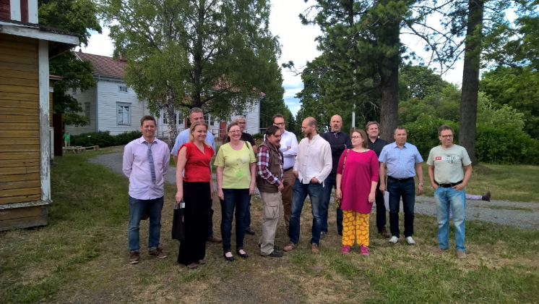
THE Standing COMMITTEE FOR SUSTAINABLE DEVELOPMENT
In Pirkkala the municipal board may set committees to plan and prepare different themes for decision making
In 2017, a Sustainable Development Standing Committee was set up with the central task of promoting sustainability in Pirkkala

Slide 27
GOALS AND political commitments
Sustainable development has become a broadly accepted aim in society. It is one of the most important cross-cutting objectives at the Pirkkala’s municipality strategy.
”Our goal is to ensure good life opportunities for present and future generations. When making decisions and putting plans into action we’ll take care of environment, people, civil rights ja aspects of economy.”

Slide 28
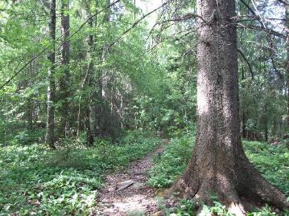
goals and poltical commitments
The municipality of Pirkkala adopted the environmental targets in 2016. Pirkkala’s targets focus on urban planning, energy, nature and education.
The local authority seeks to:
1) improve the cohesion of the urban structure by developing the town centre and improving public transport;
2) promote energy-efficient solutions and the use of renewable energy;
3) promote ecosystem services and biodiversity, and anticipate and prepare for the impact of climate change; and
4) develop environmental education materials and collaborate with companies to find solutions to environmental pollution.
Municipality of Pirkkala and all of the local authority departments have also defined their own commitments about how they can contribute to the improvement of Pirkkala’s sustainability (Commitment2050) .

Slide 29
goals and poltical commitments
Regional goals:
Regional climate Strategy 2010
The climate strategy evaluation 2016
New environmental targets for the region 2018

Slide 30
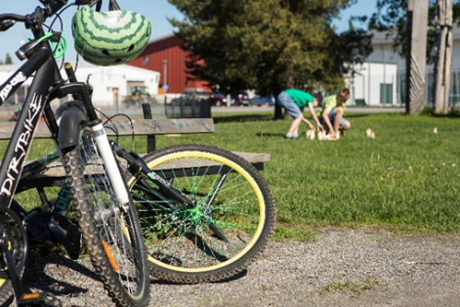
Membership in the Carbon Neutral Municipalities network (Hinku)
Pirkkala joined the Carbon Neutral Municipalities (HINKU) network by decision of its Municipal council on Feburary 2019. Also the Tampere City Region has joined the network being the largest unified region in the network in Finland. The network is coordinated by the Finnish Environment Institute (SYKE).
The members of the Carbon Neutral Municipalities network (Hinku) are committed to reducing their emissions by 80% from the 2007 level by 2030. The remaining 20 per cent will be compensated by increasing carbon sinks.
The regional climate package is a burden-sharing agreement according to which each municipality will carry out individual emissions reduction measures ideal for them.
The Tampere region is participating in the Finnish Environment Institute’s CANEMURE (Towards Carbon Neutral Municipalities) Life IP -project, which will promote practical measures to mitigate climate change over the next six years.

Slide 31
ACTIONS
The emissions reduction actions in the Tampere region are based on the region’s strategy, LHT (land use, housing and transport) agreement and climate strategy.
In the Tampere region the areas in which emissions need to be reduced most during the Hinku period of 2007–2030 are electricity, district heating and traffic.
Pirkkala’s climate work is characterised by an emphasis on sustainable urban structure, low-energy building projects and smart mobility measures. Climate education also plays a major role in the municipality’s climate work.
Pirkkala also boasts a good number of companies offering environmental solutions.
Projects in the next few years include the general planning of the tramway, which the municipality of Pirkkala is contributing to.

Slide 32
next steps
The next steps are to build road maps to set actions on how to become carbon neutral region and municipality.
The local businesses and residents are invited to participate in the in the implementation of the SDGs and climate actions eg. in the circular economy.
More comparable emission data and information on the emmision effects, costs and benefits of different measures are still needed.
The cities and municipalities need more support of a state-level policy.

Slide 33
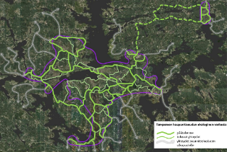
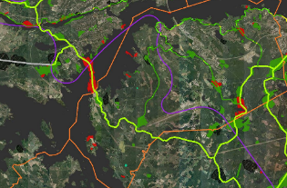
Carbon sinks and local green areas
The Tampere region’s carbon sink assessment will be completed in 2019.
Tampere region has developed ”Carbon sinks and local green areas in growing urban areas” project as part of The Sustainable City programme coordinated by the Ministry of the Environment. The project’s measures include assessing the potential of the region’s urban and rural green areas to function as carbon sinks.
On Tampere region the important forest areas and Ecological networks was identified in cooperation between Centre for Economic Development, Transport and the Environment (ELY Center) and municipalities.
The Pirkkala’s green area program is being prepared.

Slide 35
Environmental (SDG 13 and SDG 7)
Presentations:
Barbara Heinonen from the city of Mariehamn
Vesa Vanninen from Pirkkala municipality
Moderator: Elin Slätmo, Nordregio
Rapporteur: Theresia Bilola Epse Samfoga Doh, City of Turku, Finland
How do you tackle climate change within your work (in the municipality)?
How do you work for affordable clean energy?
What type of help is needed to further the work from your perspective?

